Slide 1
Leveller Update -0819

Slide 2
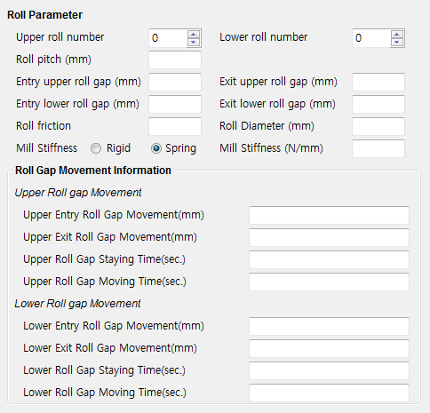
Roll Parameter 추가
Entry Roll Table Distance(mm) | %EntryRollTableDist% | Exit Roll Table Distance(mm | %ExitRollTableDist%
위의 변수를 추가해주길 부탁합니다.
a2_roll_gen.proc 의 %ExitRollTableField% 의 내용을 아래와 같이 변경이 필요함.
변경전,
point(fdist+fdist+230.0/2+roll_pitch*(4)+roll_pitch/2, 0, -1000)
point(-roll_dia/2+fdist+fdist+230.0/2+roll_pitch*(4)+roll_pitch/2, -roll_dia/2, -1000)
point(fdist+fdist+230.0/2+roll_pitch*(4)+roll_pitch/2 + L + 5000, 0, -1000)
point(fdist+fdist+230.0/2+roll_pitch*(4)+roll_pitch/2, 0, -1000)
변경후,
point(fdist+rdist+230.0/2+roll_pitch*(4)+roll_pitch/2, 0, -1000)
point(-roll_dia/2+fdist+rdist+230.0/2+roll_pitch*(4)+roll_pitch/2, -roll_dia/2, -1000)
point(fdist+rdist+230.0/2+roll_pitch*(4)+roll_pitch/2 + L + 5000, 0, -1000)
point(fdist+rdist+230.0/2+roll_pitch*(4)+roll_pitch/2, 0, -1000)

